Slide 1
Postorder Traversal
Traverse the left subtree of R in postorder
Traverse the right subtree of R in postorder
Traverse the root R.

Slide 2
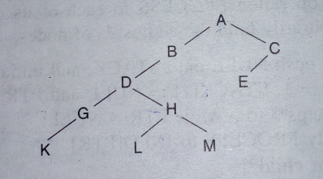
Example

Slide 3
1.)Initially, push null onto stack, Stack:=null and Ptr:=A
2.)Proceed down the left most part rooted at PTR:=A,
Pushing nodes A,B,D,G,K onto stack.
A has right child C and D has right child H, put them onto stack as negative
So, stack:= null,A,-C,B,D,-H,G,K.
Notes:
HERE WE HAVE TO POP NEGATIVE ELEMENT ALSO BUT WE DON’T HAVE TO PROCESS NEGATIVE ELEMENT

Slide 4
3.)[Backtracking]Pop:=K,G,-H
Process:=K,G.
Stack:=null,A,-C,B,D
Now set PTR:=-H and again after resetting PTR:=H
4.)Proceed down the left most part rooted at PTR:=H,
Pushing H,L onto stack.H has right child
Stack:=null,A,-C,B,D,H,-M,L
Notes:
PTR IS ALWAYS NEGATIVE ELEMENT, and PTR IA ALWAYS PUSHED ONTO STACK

Slide 5
5.)[ Backtracking]Pop and process, Pop:=L,-M
Process:=L
Stack:=null,A,-C,B,D,H.
Ptr:=-M and again after resetting PTR:=M
6.)Proceed the left most part rooted at PTR:=M,
SINCE M has no node so stack:=null,A,-C,B,D,H,M.

Slide 6
7.)[Backtracking]Pop and Process, Pop:=M,H,D,B,-C
Process:=M,H,D,B
Stack:=null,A.
Ptr:=-C and again after resetting PTR:=C
8.)Proceed the left most part rooted at PTR:=C
Stack:=null,A,C,E
9.)[Backtracking]Pop:=E,C,A Process:=E,C,A
Atlast null is popped off.

Slide 7
Solution:=K,G,L,M,H,D,B,E,C,A.

